Slide 1
CSS
MCNDHS
Ms. Eng

Slide 2
AIM: HOW DO WE CREATE BORDERS, MARGINS, AND PADDING ?
Do now:
Daily Grade:
On-time/attendance/not leaving the classroom: 25%
Cellphones: 25%
Notes:25%
Classwork/Homework: 25%

Slide 3


DECORATION OUR DIV

Slide 4
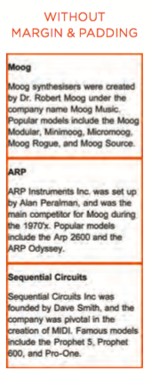
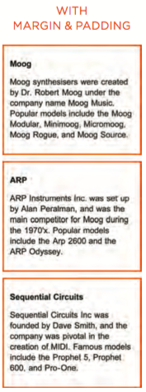
BEFORE AND AFTER

Slide 5

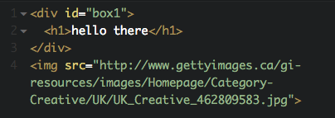
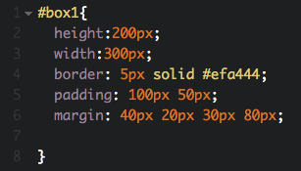
Border, margin, padding

Slide 6
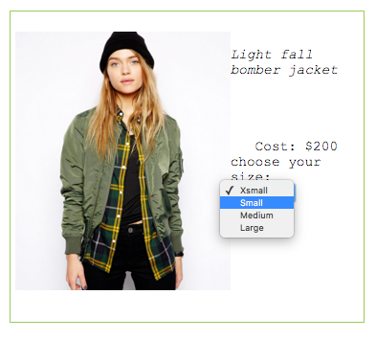
ACTIVITIY

